Slide 1
SERVICING HUB
“ONE CLICK FOR EVERY SERVICE”
PRESENTED TO: DEPARTMENT OF INFORMATION AND TECTNOLOGY
Notes:
…

Slide 2
I
INTRODUCTION :
AGENDA :
A Service Hub is a central point
that manages and provides
access to various services in an
application.
1.Centralized Service management
2.Cusmoter support & Satisfaction
3.Technician / service personnel workflow
4.Service provided efficiency
5.Billing & Invoicing
6.Inventory & tools management
7.Feedback & family control
8.Notifications & Communication
9. Admin panel
It helps in decoupling the
components by offering centralized
service management.

Slide 3




Services
1.Repair & Maintenance Services
2.Cleaning Services
1) AC , fridge ,
washing machine
2) Plumbing services
3) Electrical repair
House deep cleaning
Carpet & Sofa cleaning
Kitchen / bathroom
cleaning
3.Installation Services
4.Personal Care Services
1)Salon at home
2)Massage theropy
3)Bridal Makeup
1)TV,Water purifier
2)Electrical fixture Installation
3)CCtV setup

Slide 4
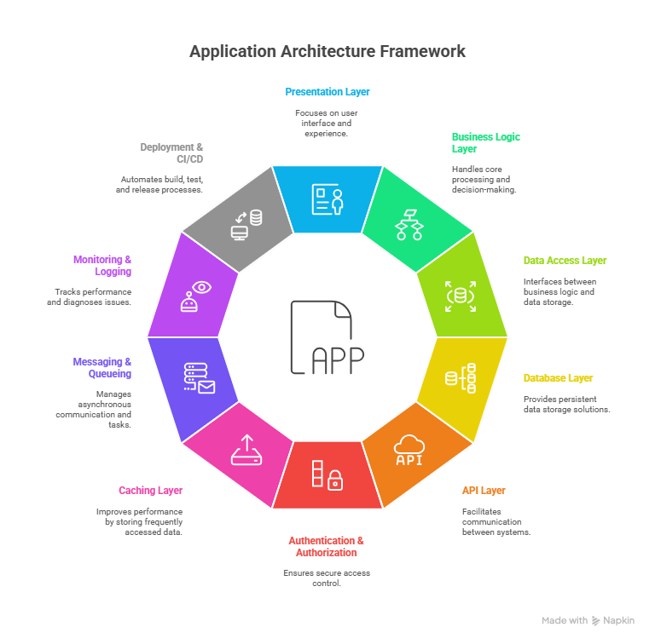
Technical Approach
Tools
1.Frontend : HTML / CSS / Javascipt
2.Backend : Java & Spring Boot
3.Database: Mysql / File-based storage
4.Admin dashboards : React Admin
5.Authentication & security testing : Spring security test
6.Testing : Cypress

Slide 5
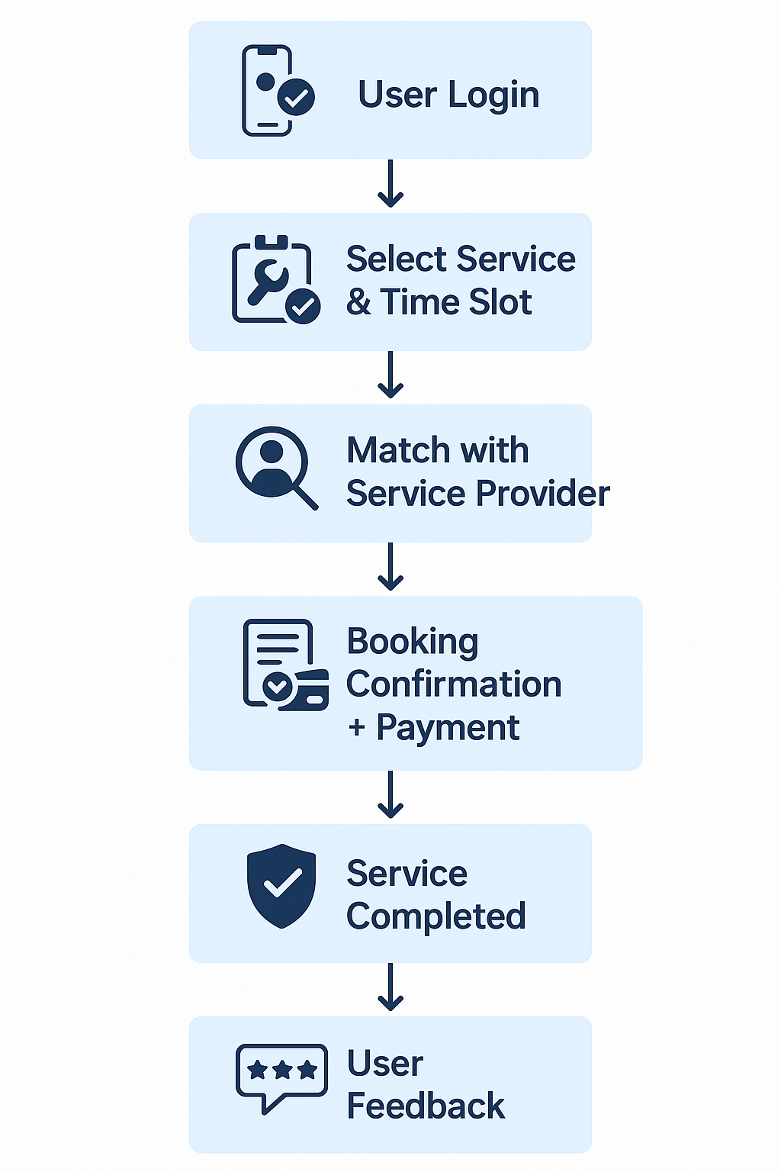
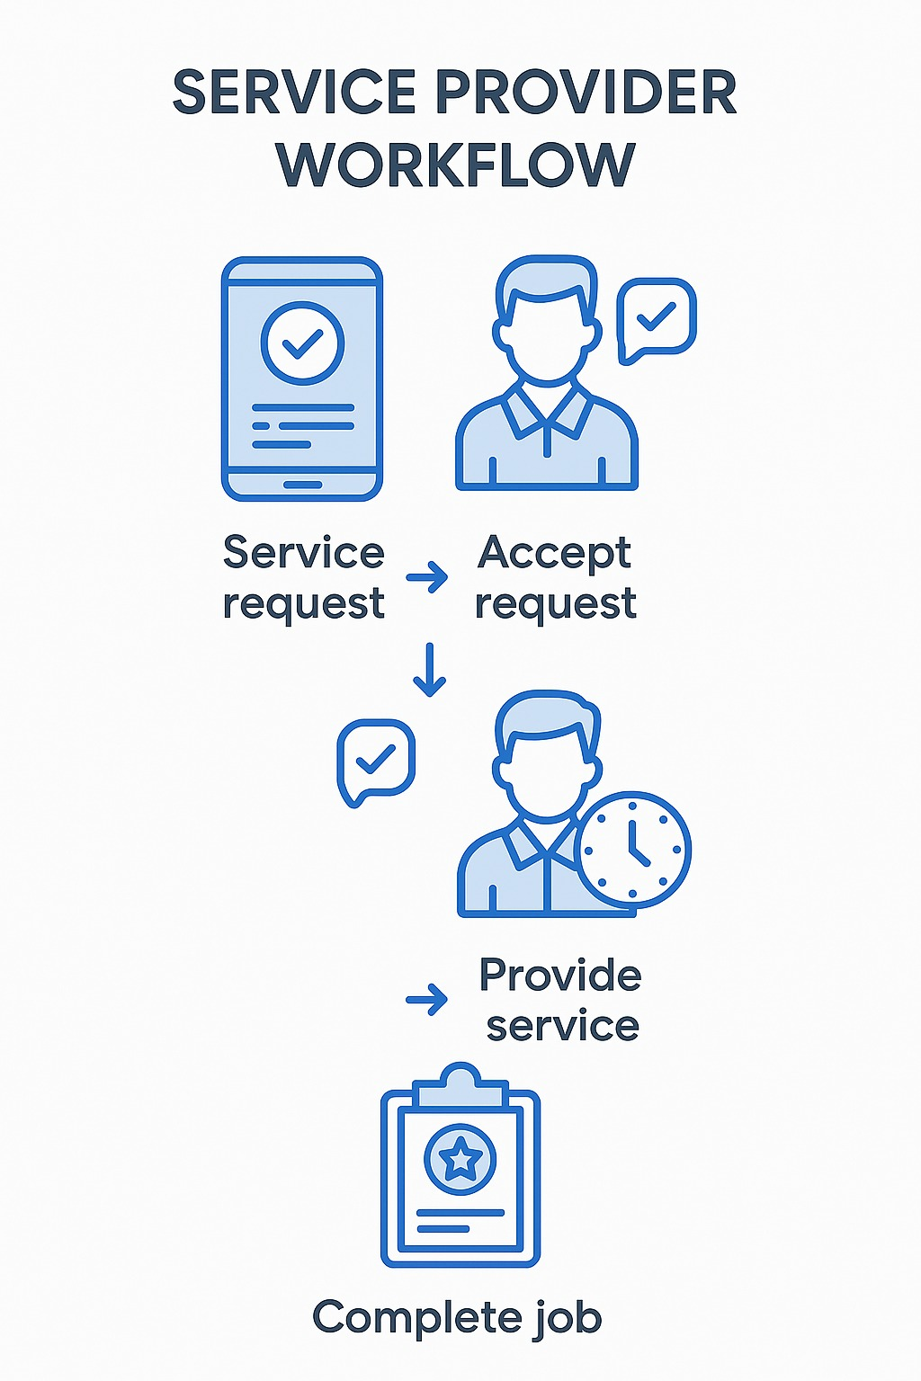
WORKFLOW
CUSTOMER
SERVICE PROVIDER
1.User logs in
2. Select service &
Slot time
3.App matches with
available service
provided
4.Booking confirmed &
payment processed
5.Service completed ,
user gives feedback
1.Login & profile setup
2.Receive request
3.Accept / Reject booking
4.Navigate to customer
location
5.Start & Perform service
6.Payment collection
7.Get feedback
8.Dashboards & earnings

Slide 6
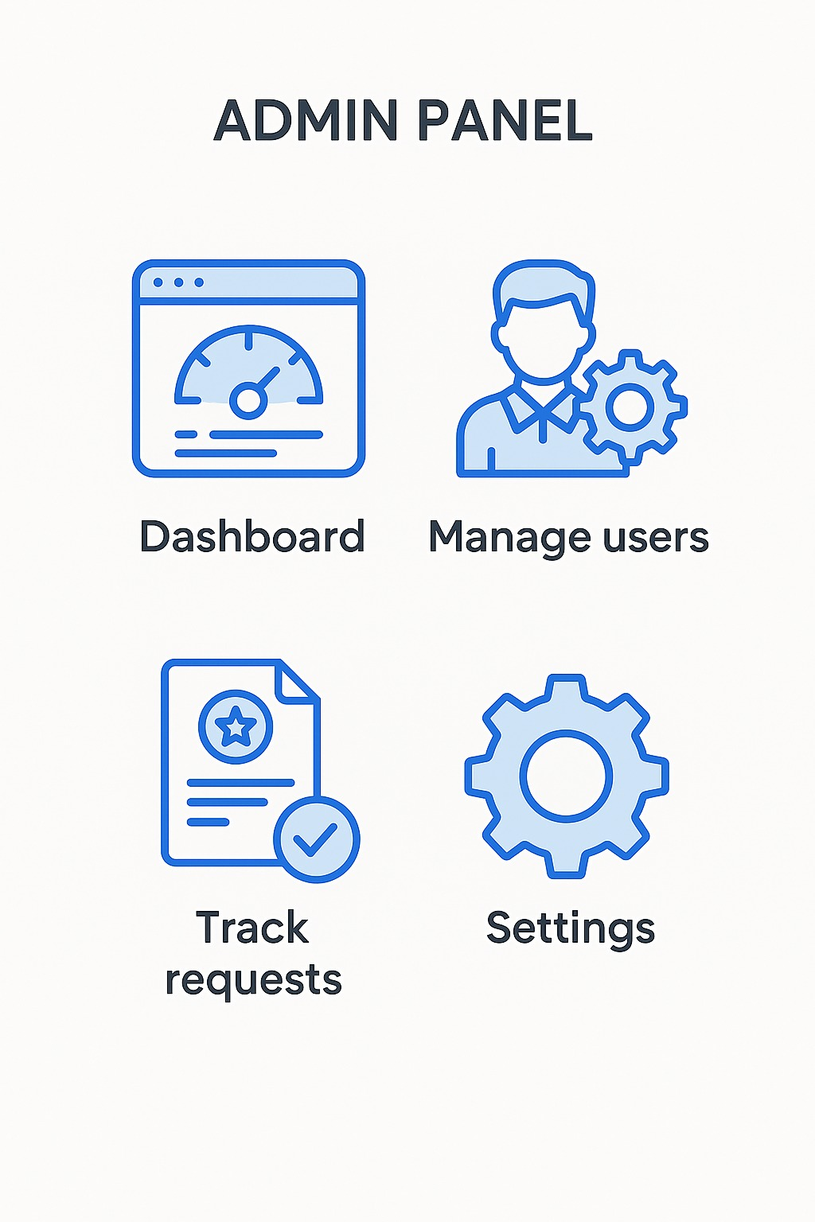
ADMIN PANEL
Dashboard
User Management
Service Management
Booking Management
Payment & Commission Management
Feedback & Complaint Handling
Promotions & Coupons
8. Notifications & Alerts
9. Manage

Slide 7




PERKS
1. Easy booking & scheduling
1. Growth in payment
Often with overtime or shift
differential pay
No pressure of boss
Book services 24/7 via app
Real-time availability & calendar view
2. Service history
2. Performance ratings
View past services & invoices
Based on service quality, customer
feedback, or monthly targets.
Rebook or repeat orders easily

Slide 8
CONCLUSION
Project Impact
Simplifies service access and delivery
Enhances user experience with intuitive features
Bridges communication between users and providers.
Development Highlights:
Hands-on backend + frontend (Java, Swing, Spring Boot)
Practical deployment strategies explored
Focused on real-world use and scalability
Looking Ahead:
Expand to new services
Improve security and performance
Boost user retention and engagement

